Slide 1

Workshop on phenotyping standards Examples of data management Advantages of using standards
Anne-Françoise Adam-Blondon
& Célia Michotey
29-30 April - Lund

Slide 2
Example of data management
Management of forest tree data in INRA’s Forest, Grassland and Freshwater Ecology department

Slide 3
Forest tree data management
Local IS 1
Local Information System
Daily data management
Different kind of data produced by researches
Raw data
Analysed data
Inventory management
Management of specific data
Global Information System
Centralized and sustainable data management
Improved data visibility and knowledge sharing
Dataset interoperability
Enhance data quality, reuse and enrichment
Local IS 2
Global IS
unifying
Notes:
Avantages architecture :
facilite gestion quotidienne RBF en local
tampon entre acquisition et valorisation :
que données finalisées (curation manuelle)
tout n’a pas vocation à remonter dans SI global (stockage matériel, ITK …)

Slide 4


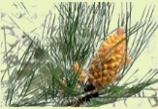
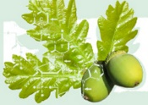
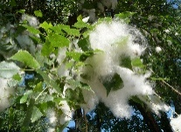










Interoperability between IS
National Network
International Network
FAIDARE
Pinus Portal
Quercus Portal
Populus Portal
Local Database
File
PlantaExp
Quercus Portal
Pinus Portal
Symphonie
Pl@ntNet
GIDE
Global Database

Slide 5
Example of interoperability implementation GnpIS => TEMPO
GnpIS
IS managing genomic, genetic and phenomic data for plants and crop parasites
Global IS for INRA’s forest tree data
TEMPO
French network of observatories dedicated phenology for plants and animals (farmed or wild)
Steps to interoperability
Data standardization in each SI
Data mapping between SI
Setup of the data flow between SI

Slide 6
GnpIS => TEMPO: Data Standardisation
Phenotype = observation of a genotype in an environment
Phenotyping experiment describe with MIAPPE (Minimum Information About Phenotyping Experiment)
Observation describe with a Variable = Trait + Method + Scale => CropOntology (Woody Plant Ontology for forest data)
Genotype describe with MCPD (Multi-Crop Passport Descriptors)
Usage of unique identifiers, ex: DOI

Slide 7
GnpIS => TEMPO: Data Mapping
Key data in GnpIS
Key data in TEMPO
Genetic resources
Taxon name and a field per rank
=> scientific name, genus, species, cultivar, variety …
Accession name and its nature (population, cultivar, clone …)
Geolocation
Site name
Geographical location (city, country …)
GPS coordinates optional
Phenotyping
All observed variables, including phenological variables
BBCH scales optional
Evaluation of the current BBCH stage when visiting the trial
Genetic resources
Taxon name and a field per principal rank
=> scientific name, genus, species, variety, cultivar
Accession name
Geolocation
Site name
GPS coordinates
Phenotyping
Only phenological variables
Only BBCH scales
Evaluation of the date when the BBCH stage is observed for the first time

Slide 8
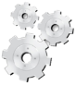

GnpIS => TEMPO: Data Flow
Definition of the standards to exchange data
Creation of a web service layer
=> Data always up-to-date
WebServices

Slide 9
Example of federation: Data discovery
Data discovery (beta)
GnpIS: https://urgi.versailles.inra.fr/data-discovery-beta/
WheatIS: https://urgi.versailles.inra.fr/wheatis-beta/
RARe: https://urgi.versailles.inra.fr/rare-beta/

Slide 10





Data discovery in distributed databases
Centralized Index

Slide 11
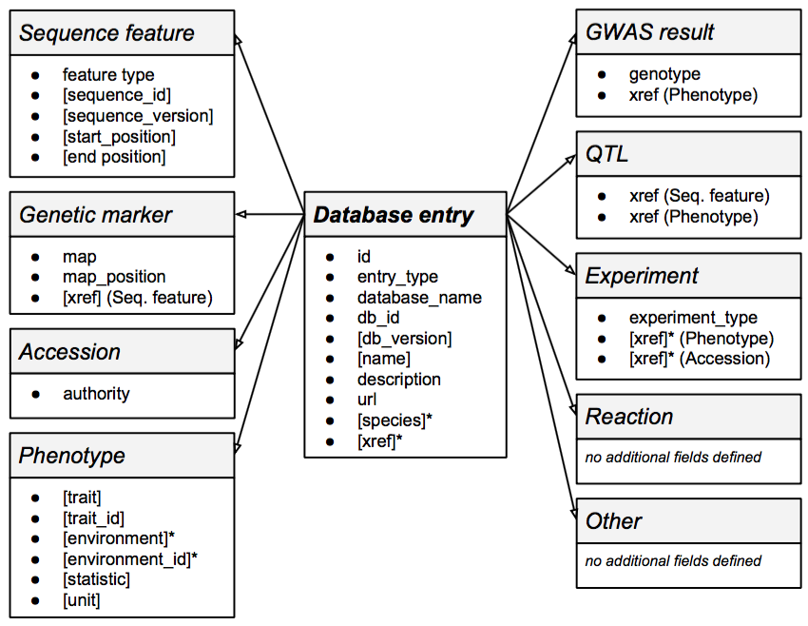
TransPLANT data model

Slide 12
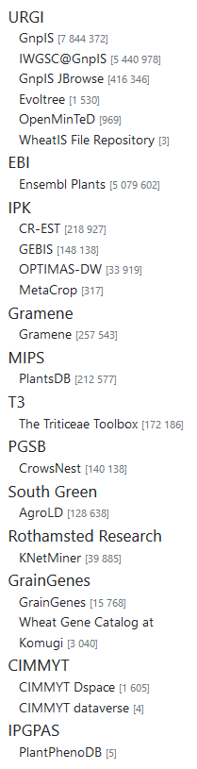
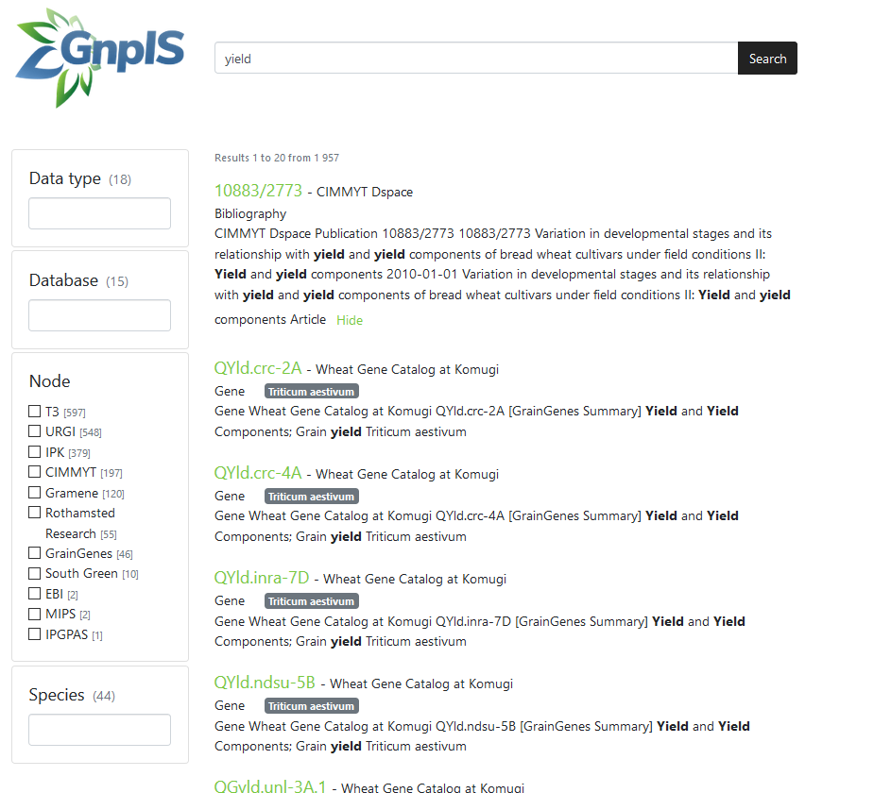
Data discovery tool
https://urgi.versailles.inra.fr/data-discovery-beta

Slide 13
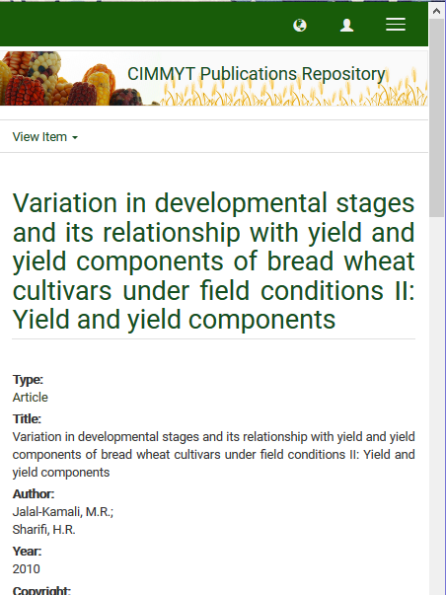
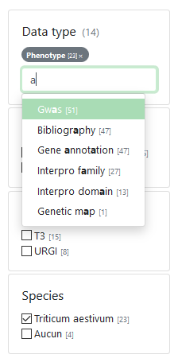
Data discovery tool
https://urgi.versailles.inra.fr/data-discovery-beta

Slide 14
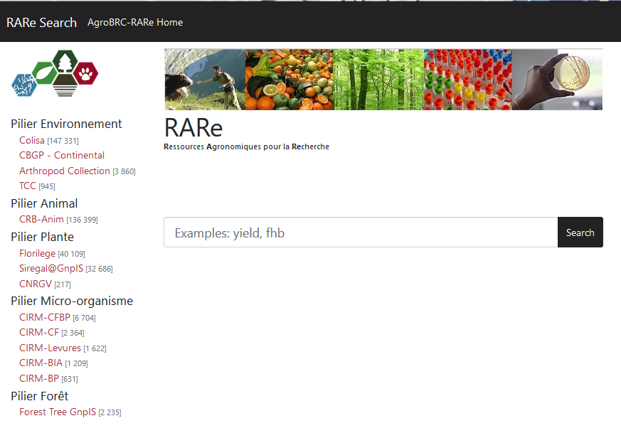
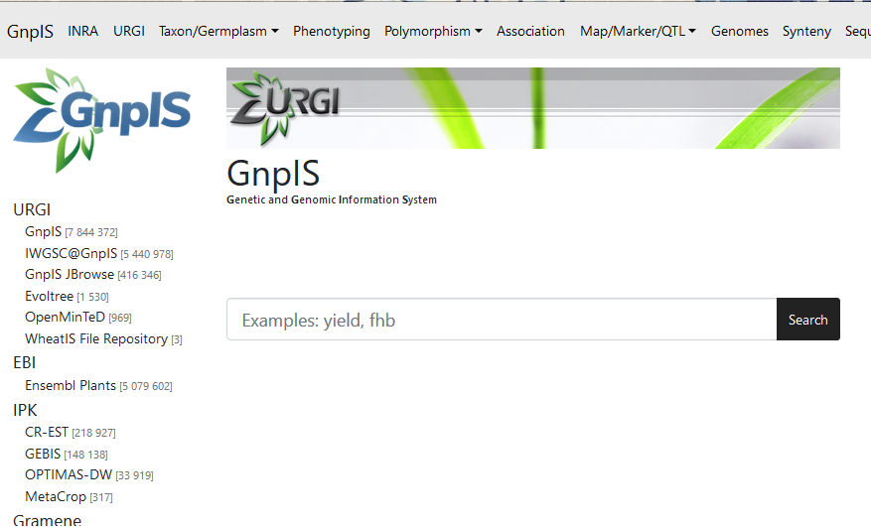

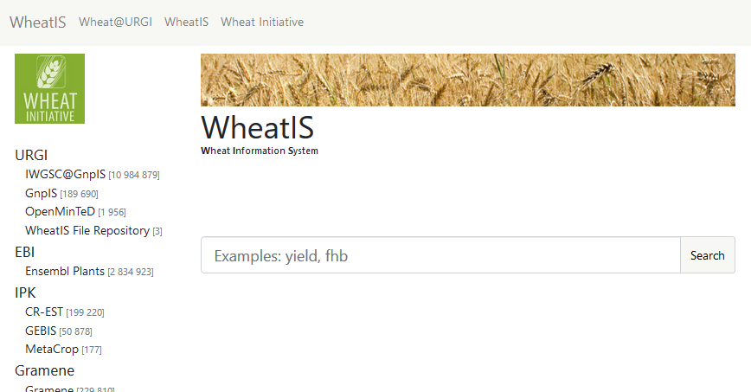
Different flavors of data discovery
https://urgi.versailles.inra.fr/data-discovery-beta/
https://urgi.versailles.inra.fr/rare-beta/
https://urgi.versailles.inra.fr/wheatis-beta/

Slide 15
Example of standard for federation: BrAPI
BrAPI: https://brapi.org/
FAIDARE (beta): https://urgi.versailles.inra.fr/gpds/

Slide 16









Breeding API (BrAPI)
Application Programming Interface (API)
A set of clearly defined methods of communication among various components
Breeding API (BrAPI)
Standard Open API for plant phenotyping and genotyping data (MCPD/MIAPPE compatible)
Enable interoperability among plant breeding databases/applications to exchange data
International collaboration
http://brapi.org/
Main implementations
CGIARs international network: Integrated Breeding Platform
Elixir Excelerate
Emphasis
Flapjack : genotyping data visualization

Slide 17

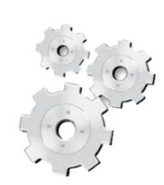




Elixir Federation with BrAPI
INRA
Data Harvester
VIB
IBET
…
…
MCPD

Slide 18

Elixir Federation with BrAPI
INRA
Data Harvester
VIB
IBET
…
…
MCPD
EBI
…

Slide 19
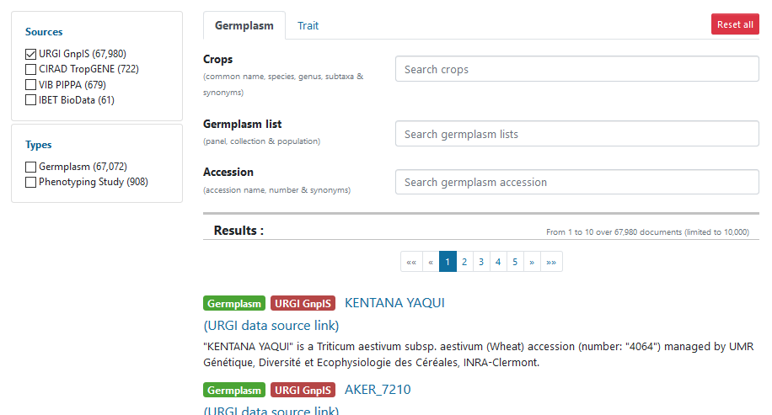
FAIDARE (FAIR Data-finder for Agronomic Research)
https://urgi.versailles.inra.fr/gpds

Slide 20
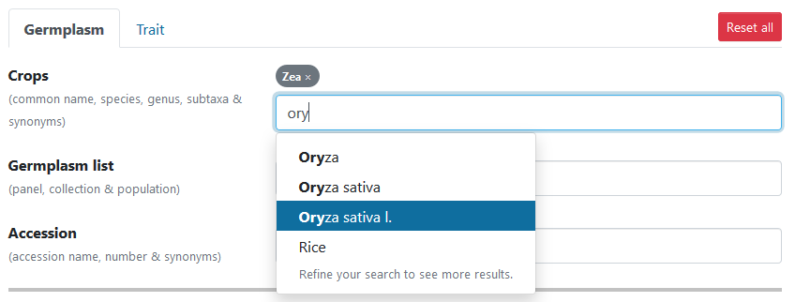
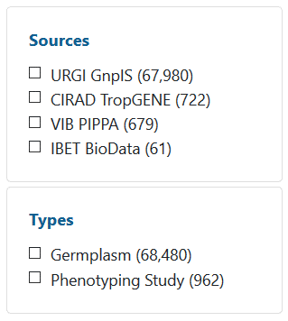
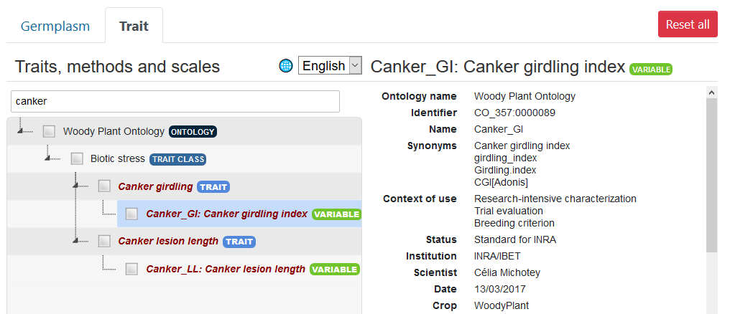
FAIDARE (FAIR Data-finder for Agronomic Research)
https://urgi.versailles.inra.fr/gpds

Slide 21
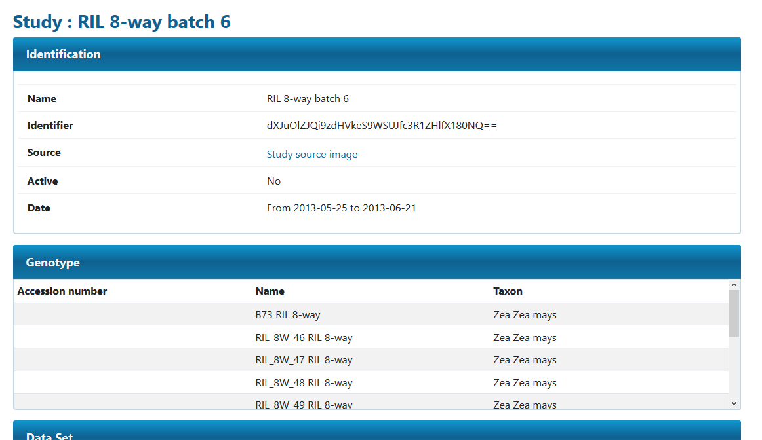
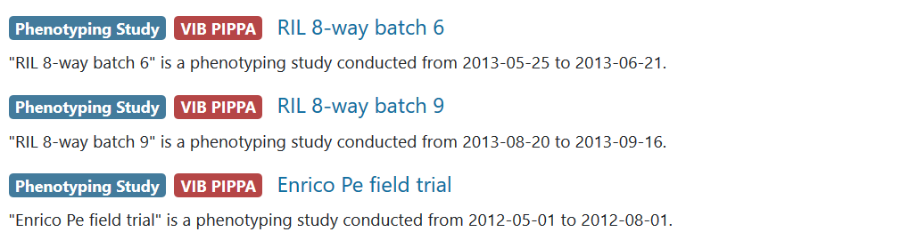

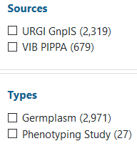
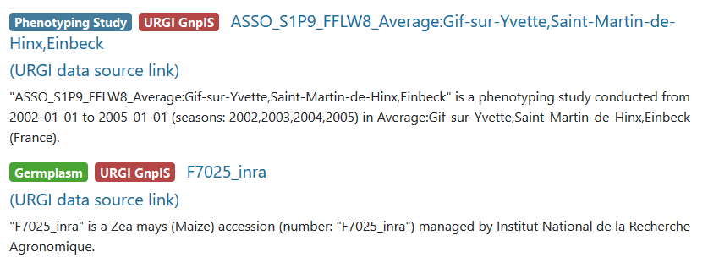
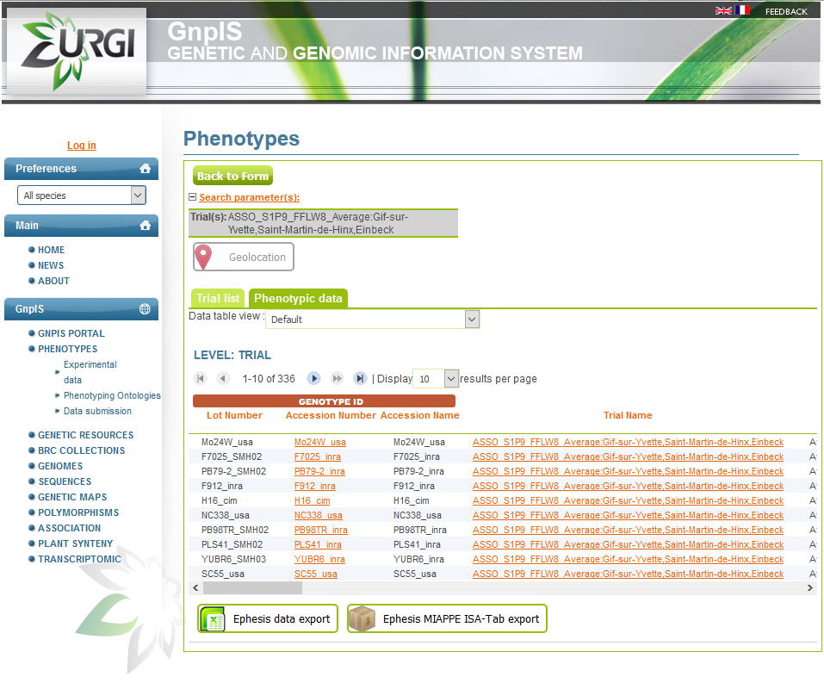
FAIDARE (FAIR Data-finder for Agronomic Research)
https://urgi.versailles.inra.fr/gpds

Slide 22
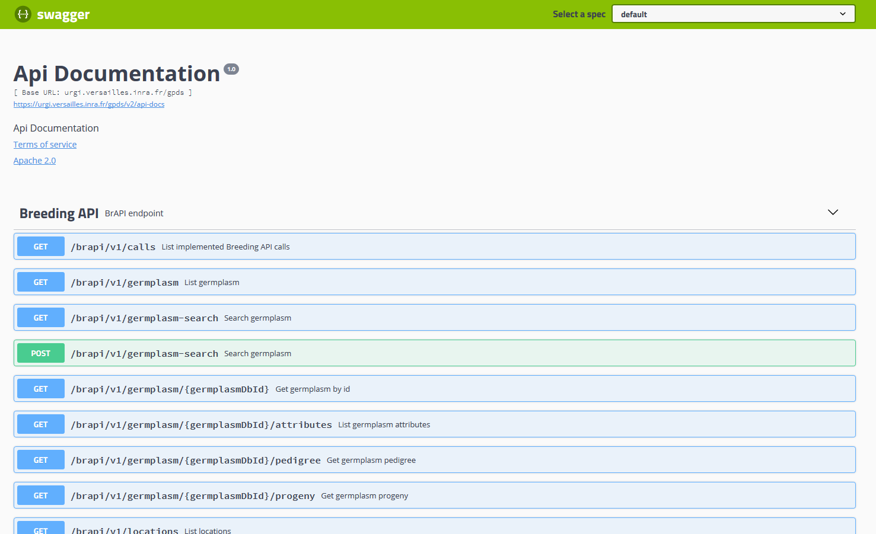
FAIDARE (FAIR Data-finder for Agronomic Research)

Slide 23
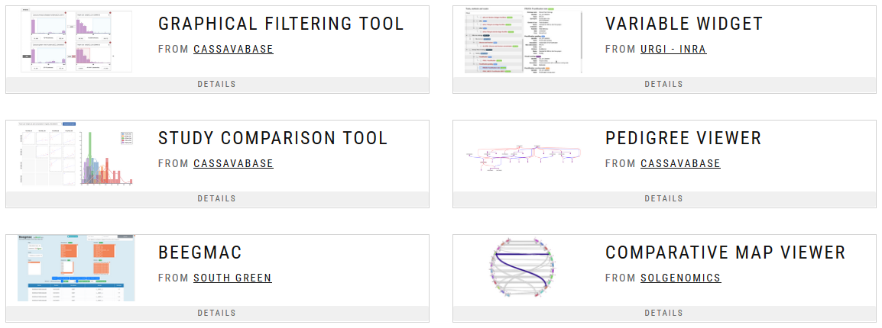
BrAPI tools
BRAVA: BrAPI Validator http://webapps.ipk-gatersleben.de/brapivalidator/
R libraries
BrAPPS: BrAPI Applications https://brapi.org/brapps

Slide 24


